Slide 1
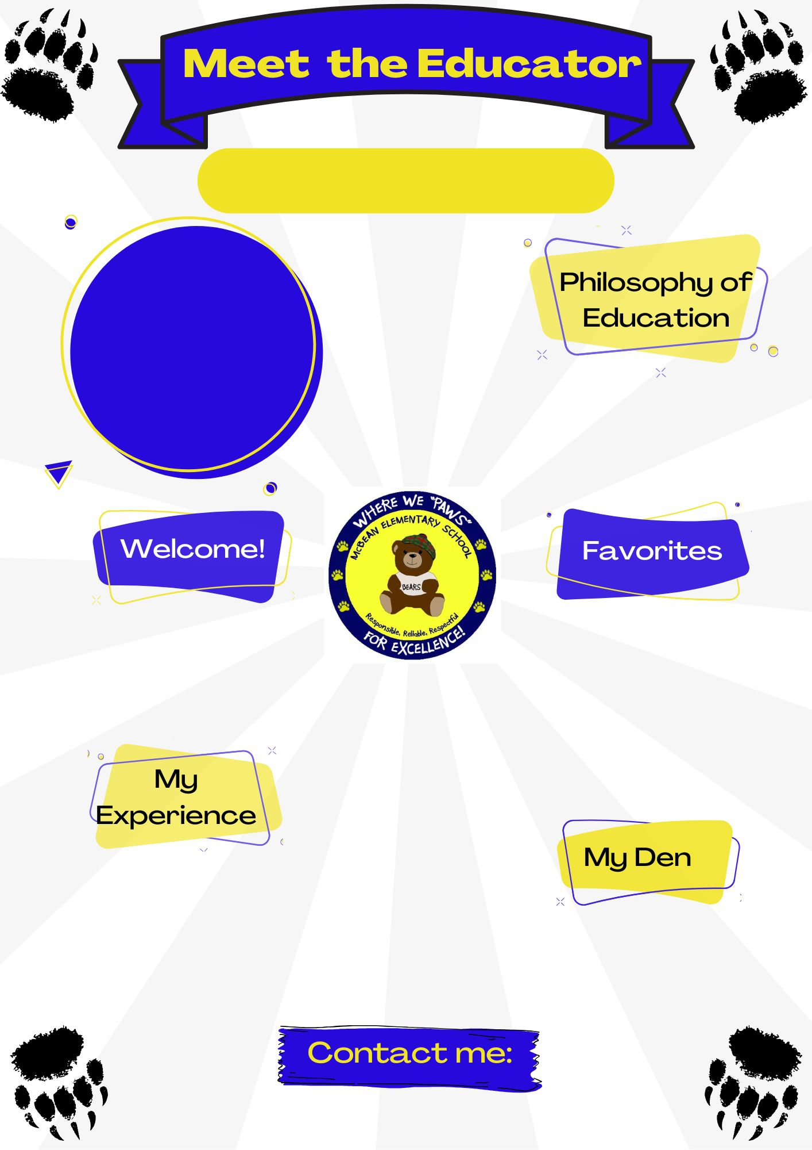
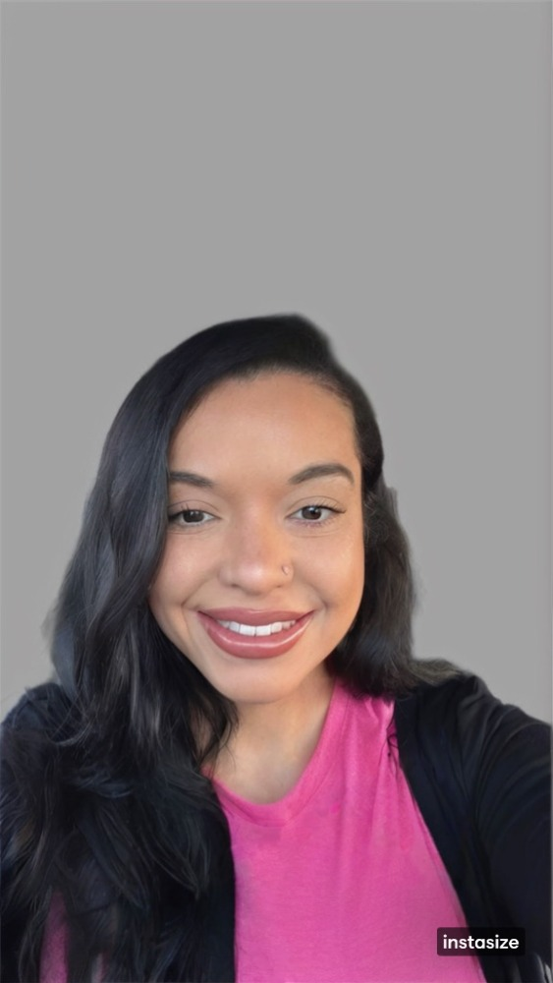

Jazlyn Foster
2025- 2026
Insert picture here
"If they can't learn the way we teach, we teach the way they learn."
-Dr. O. Ivar Lovaas
I’m Mrs. Foster, and I’m so excited to be your teacher this year! We’re going to learn, grow, and have so much fun together. I can’t wait to get to know each of you and make this year amazing!
Let’s make it a great start! 🌟
Color(s): Pink
Animal(s): Dog
Hobby: Shopping
Sport: Basketball
Book: The Bad Seed by Jory John
Movie: The Notebook
Food: Chick Fil-A
Drink: Dunkin
6 years in special education.
Bachelors of Arts in Sociology and Criminal Justice from UNC Pembroke.
Masters of Arts in Teaching Special Education from Fayetteville State University.
fosteja@boe.richmond.k12.ga.us

